Slide 1

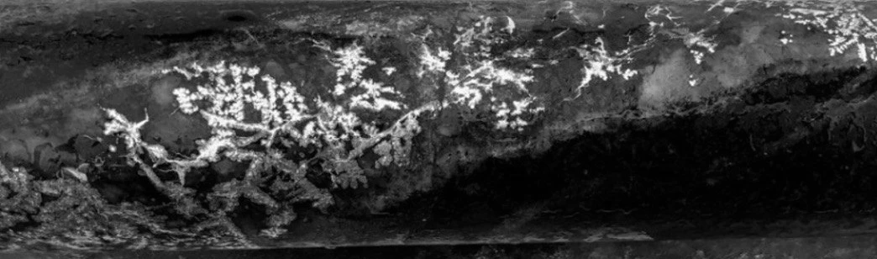
NORD PRECIOUS METALS
Corporate Presentation
May 2026
TSX-V: NTH . OTCQB: CCWOF . FF: QN3

Slide 2
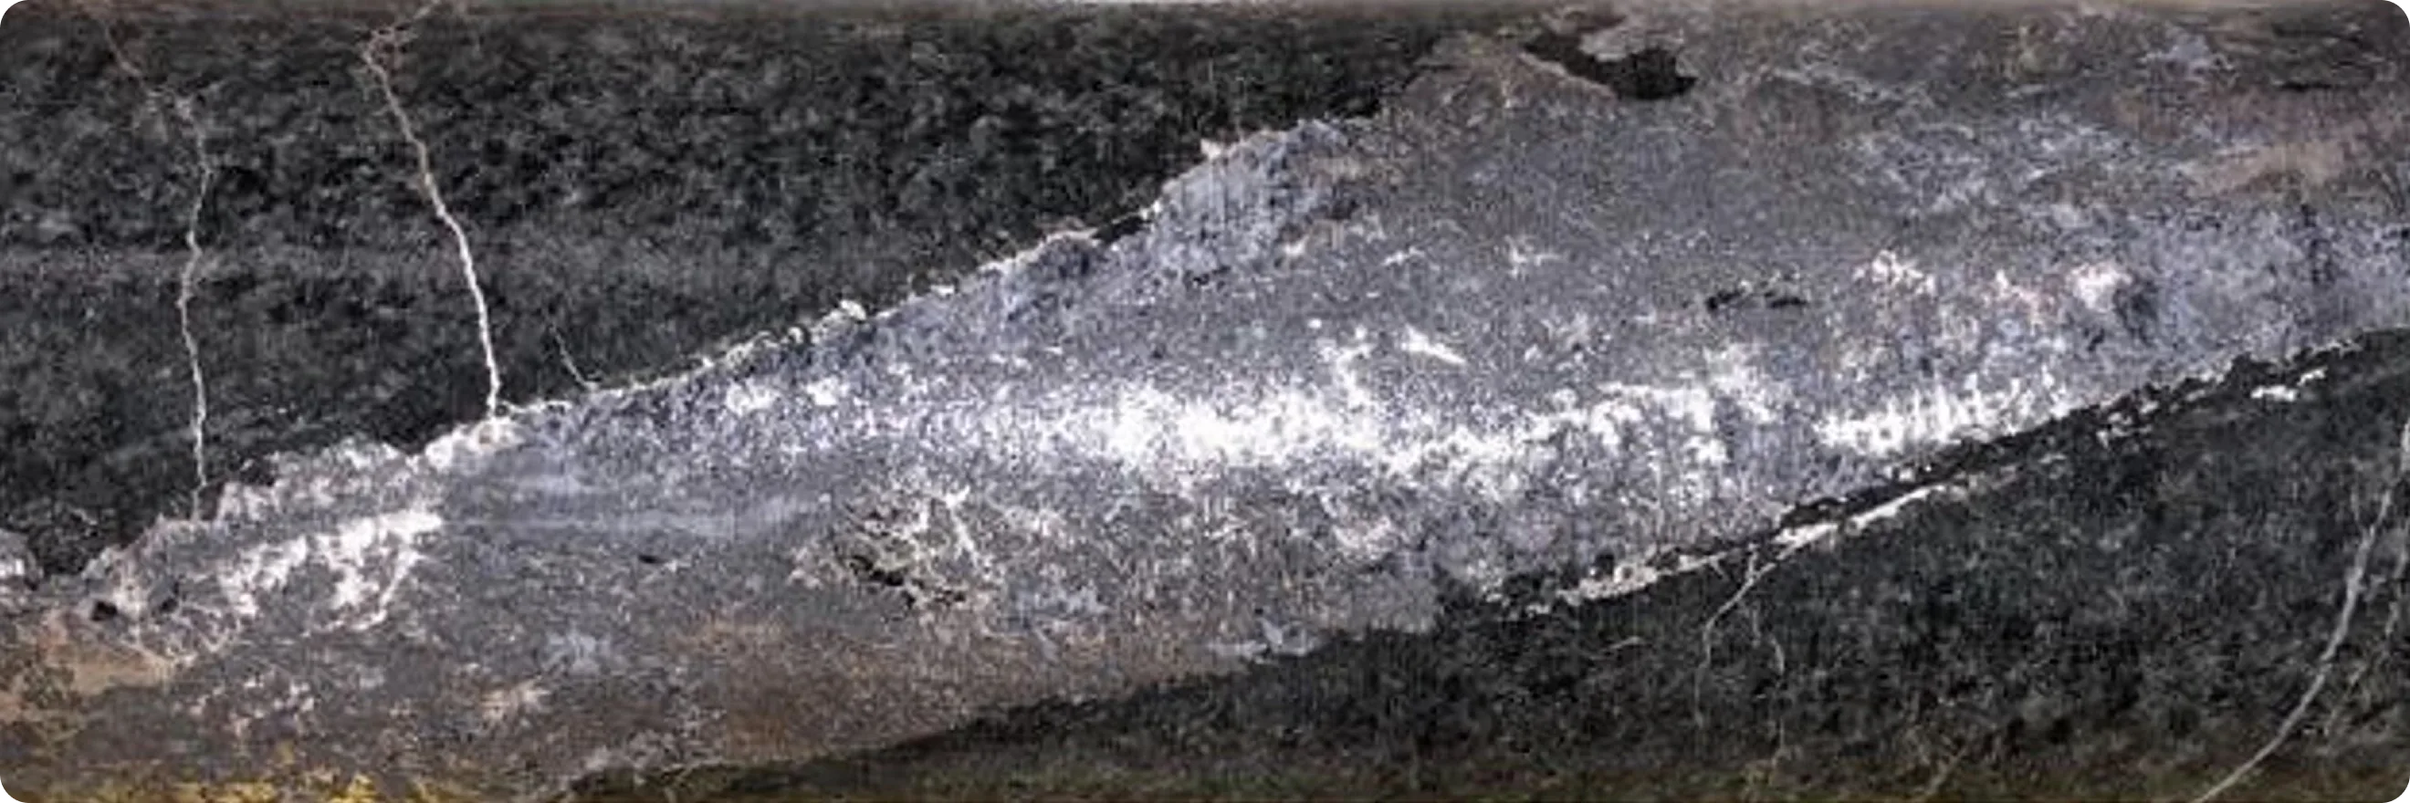
FORWARD LOOKING STATEMENTS
DISCLAIMER
Neither the TSX Venture Exchange nor its Regulation
Service Provider (as that term is defined in the
policies of the TSX Venture Exchange) accepts
responsibility for the adequacy or accuracy of this
material.
This presentation may contain forward-looking
statements including but not limited to comments
regarding mineral resources and the timing and
content of upcoming work programs, geological
interpretations, receipt of property titles, potential
mineral recovery processes, etc. Forward-looking statements address future events and conditions and therefore, involve inherent risks and uncertainties.
Actual results may differ materially from those currently anticipated in such statements. The
Company does not undertake to update any forward
looking information in this presentation or other communications unless required by law.
QUALIFIED PERSON
The technical information in this corporate presentation was reviewed and approved by Nord Precious Metals Mining Inc. President and Chief Operating Officer Matt Halliday, P. Geo., who is a Qualified Person in accordance with National Instrument 43-101.
TSX-V NTH | OTCQB CCWOF | FF 4T9B

Slide 3
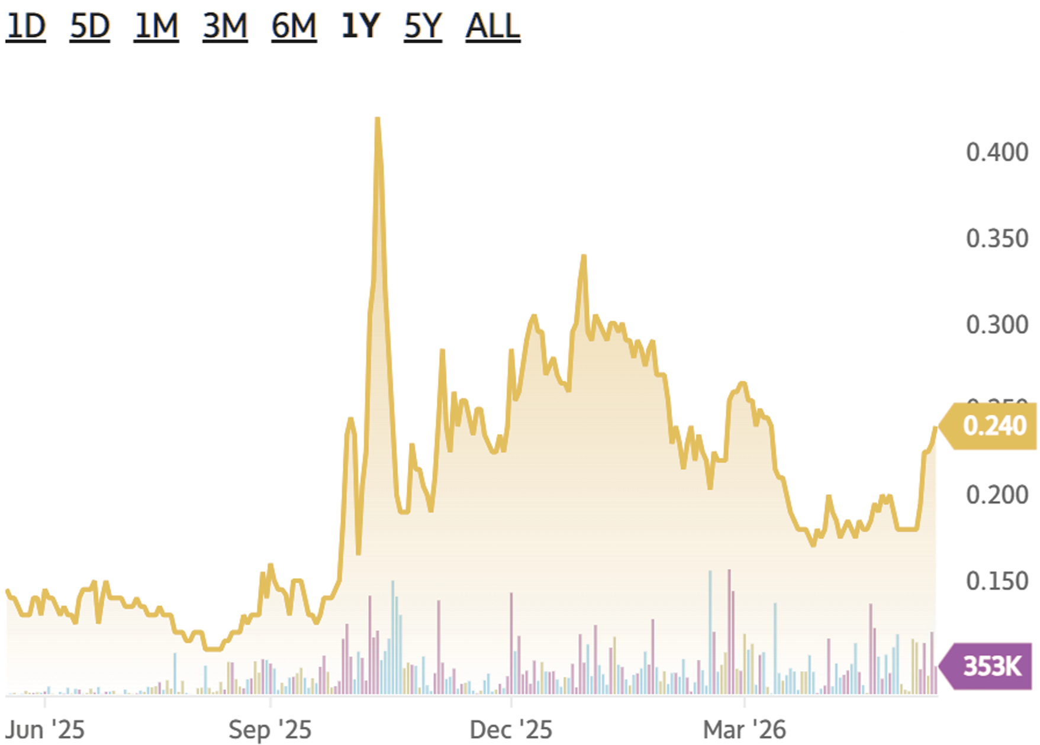
TSX-V NTH | OTCQB CCWOF | FF QN3
Nord Precious Metals
Snapshot
Previous producing mines
57 Moz
Combined Castle, Beaver, Miller Lake (1)
Ontario Canada
Tier 1
jurisdiction
Market Cap
$32.75M CAD
07-05-26
Share Price
0.24 CAD
12-05-26
Strong relationship with First Nations
in place with agreements
Large exploration potential
In Miller Lake Basin, Where Only Periphery Has Been Explored
Excellent infrastructure
Quick access to labour force
High grades
8,582 g/t
Inferred average grade
*Historic resource (2)

Slide 4
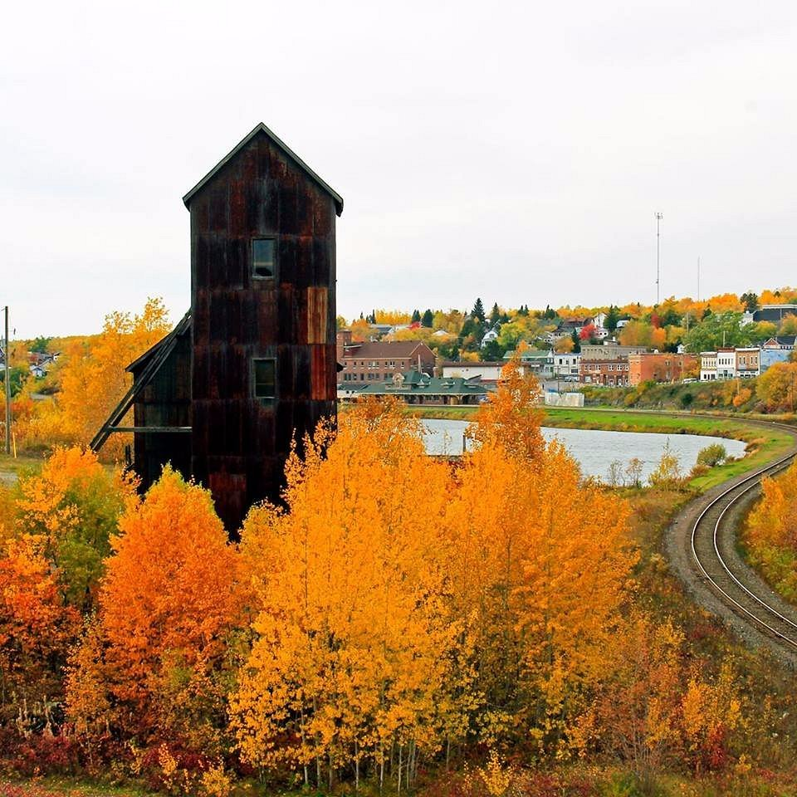
TSX-V NTH | OTCQB CCWOF | FF QN3
Nord Precious Metals
Cobalt Camp
Ontario is a Tier 1 mining jurisdiction
The Cobalt Camp is one of the world’s highest-grade primary silver districts, with 500 Moz+
of historic production and dense network of past-producing mines.
Narrow, high-grade vein mining
Notes:
500Moz
Not including south Lorraine etc
Part of Lake Temiskaming Structural Zone
Hosted in Nipissing diabase intrusions + Archean volcanics/sediments

Slide 5
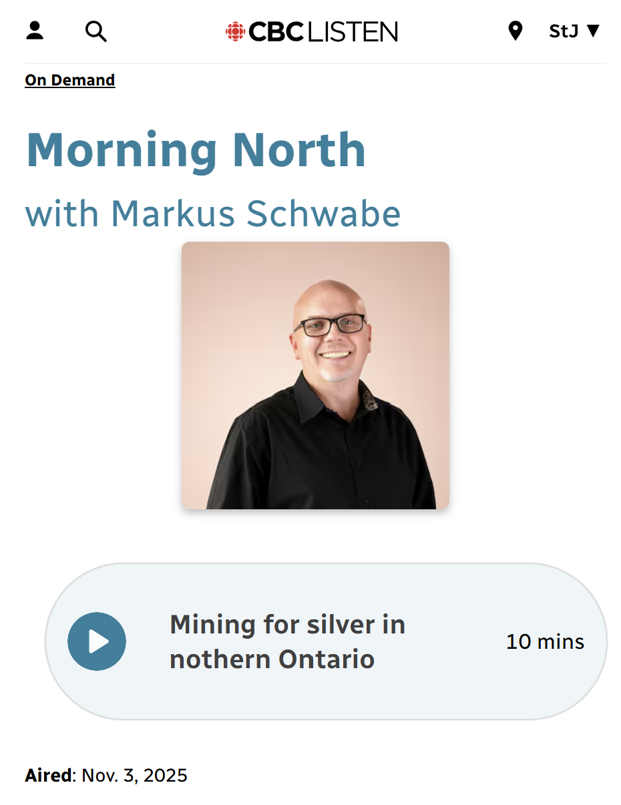
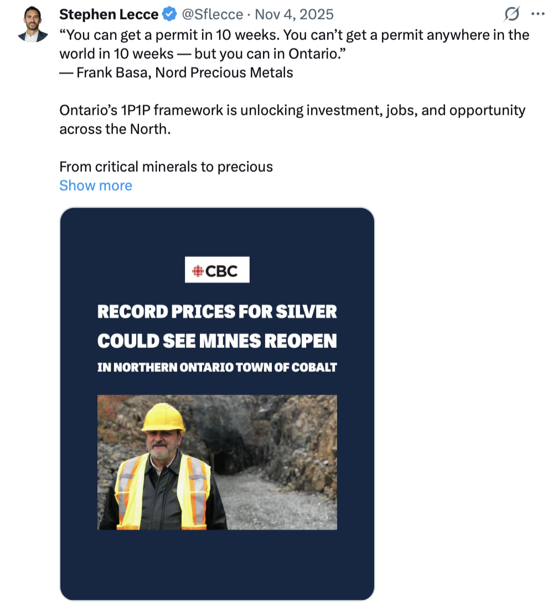
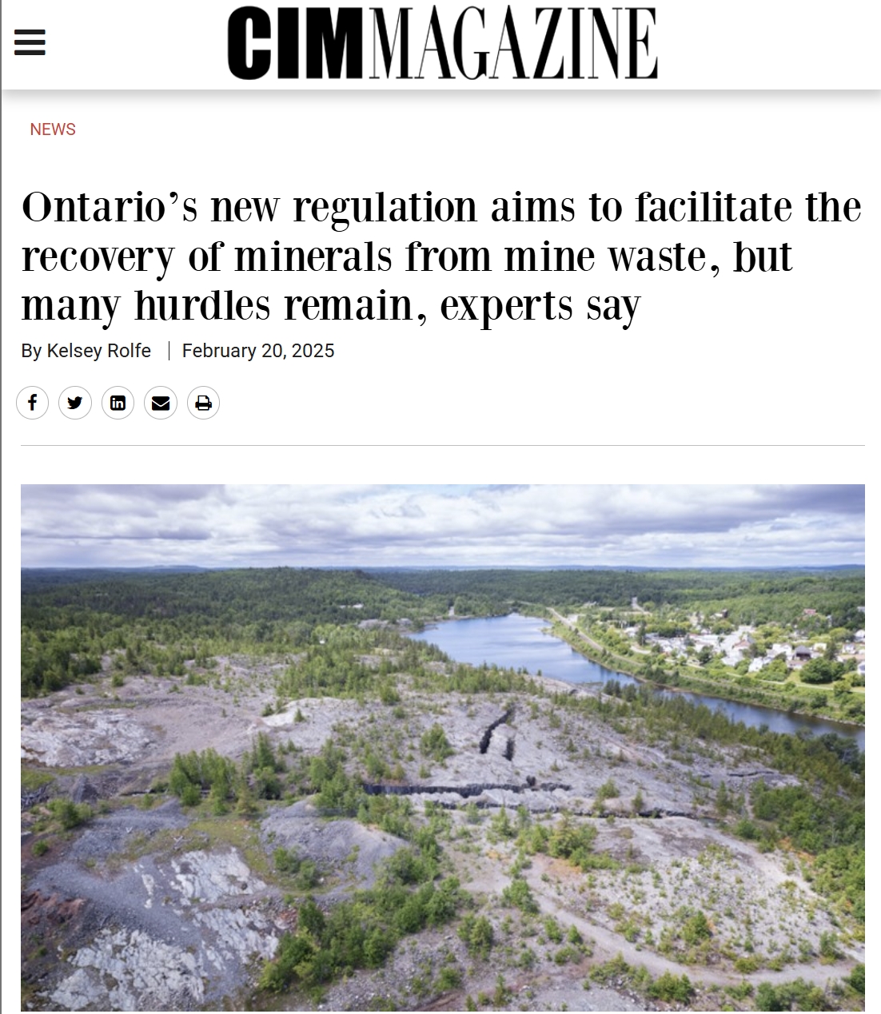
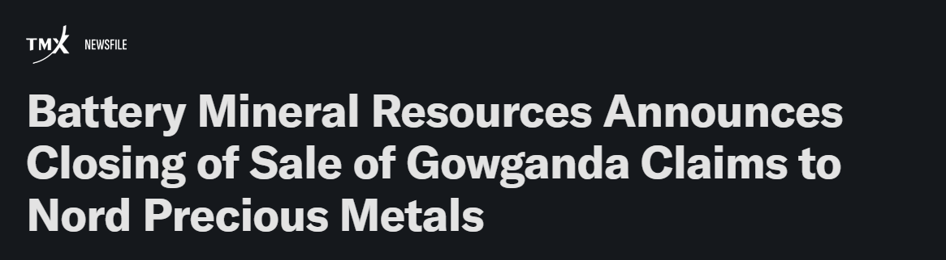
TSX-V NTH | OTCQB CCWOF | FF QN3
Government & Media Validation
The Moment for Ontario Silver
Ontario Minister of Energy and Mines
Canadian Institute of Mining

Slide 6
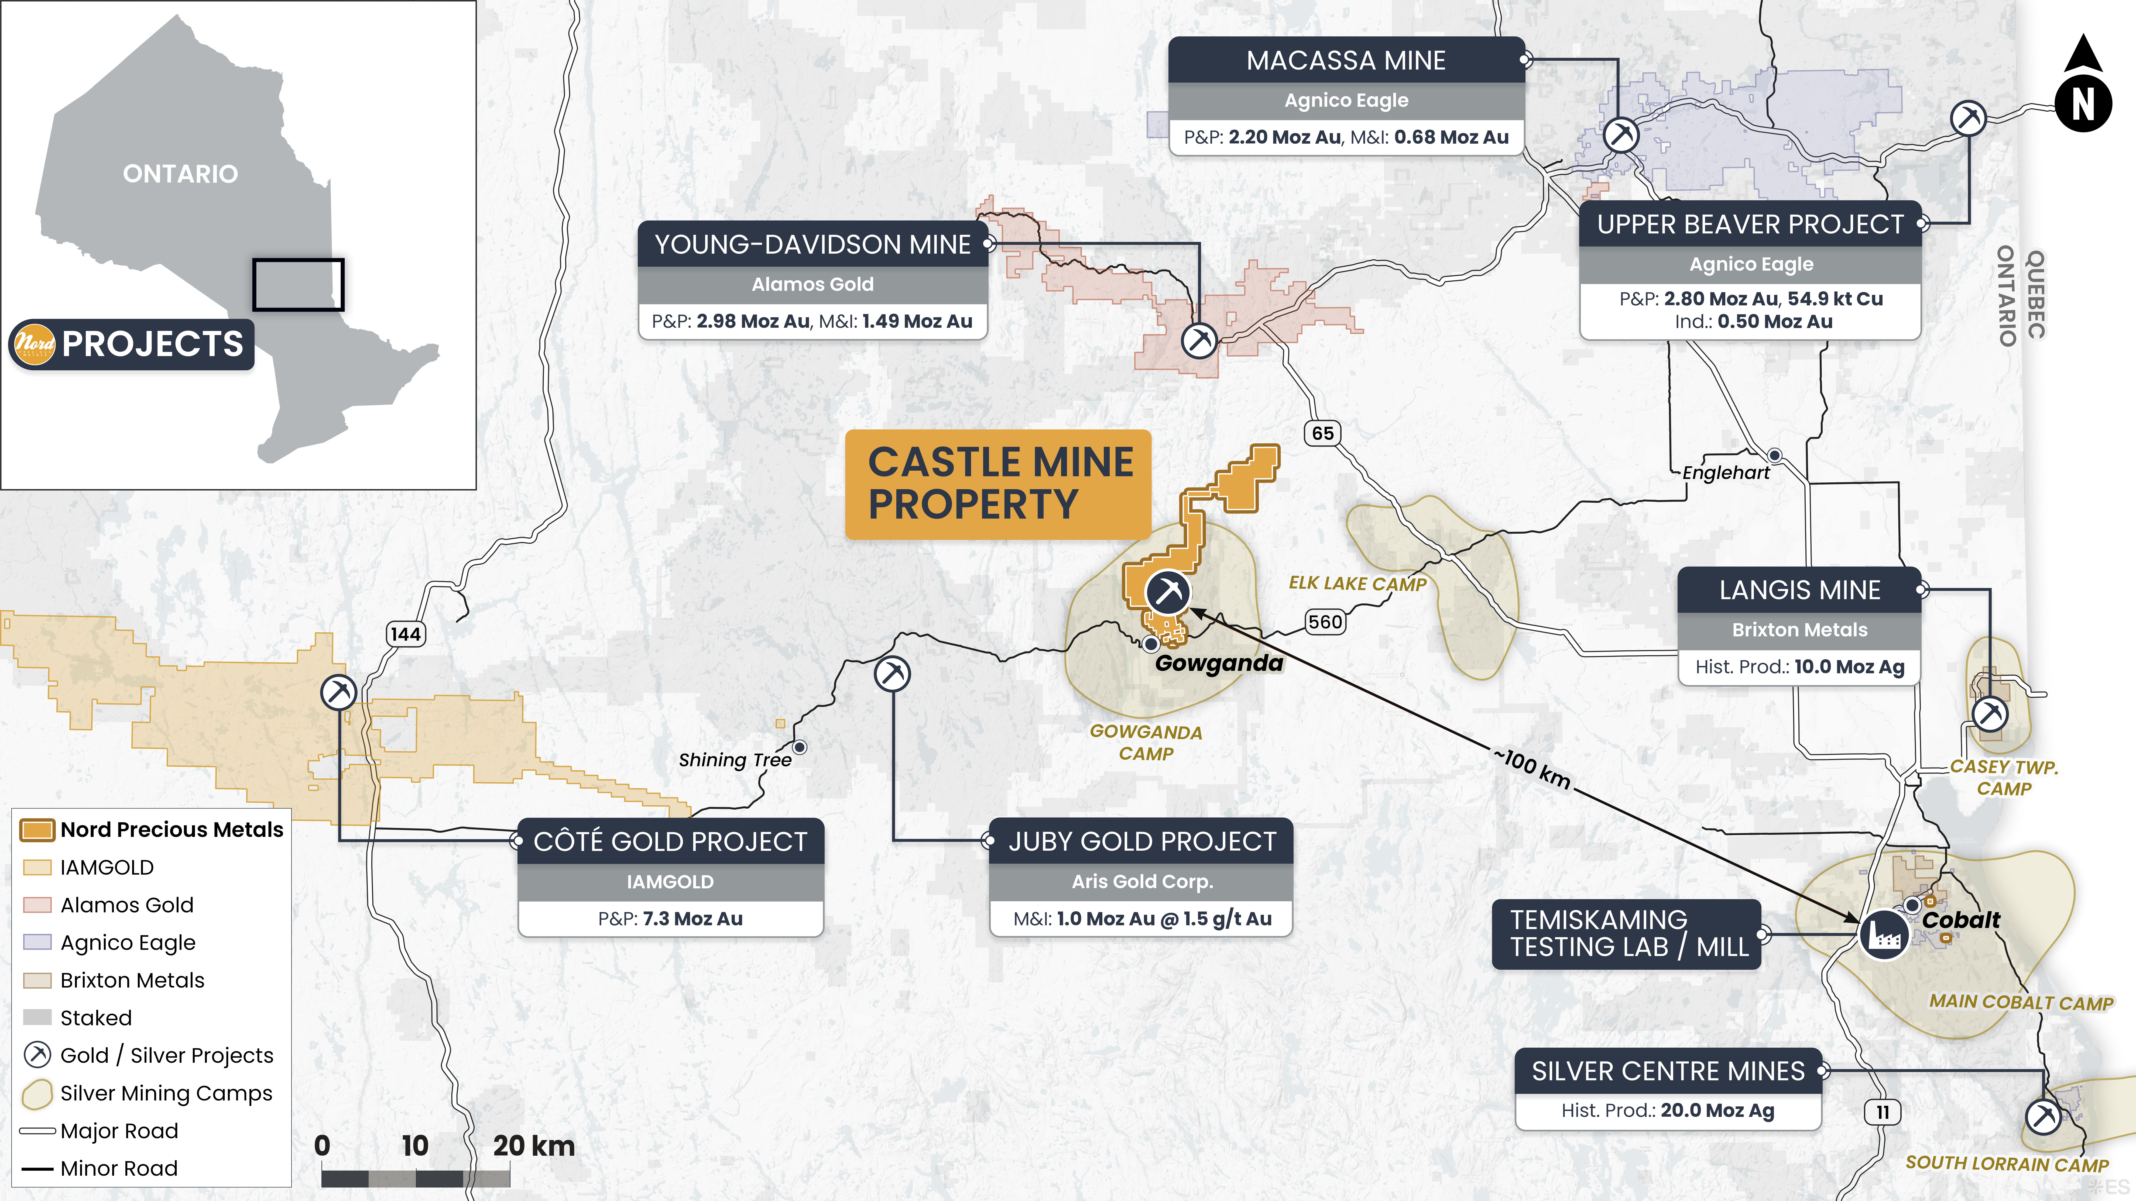
TSX-V NTH | OTCQB CCWOF | FF QN3

Slide 7
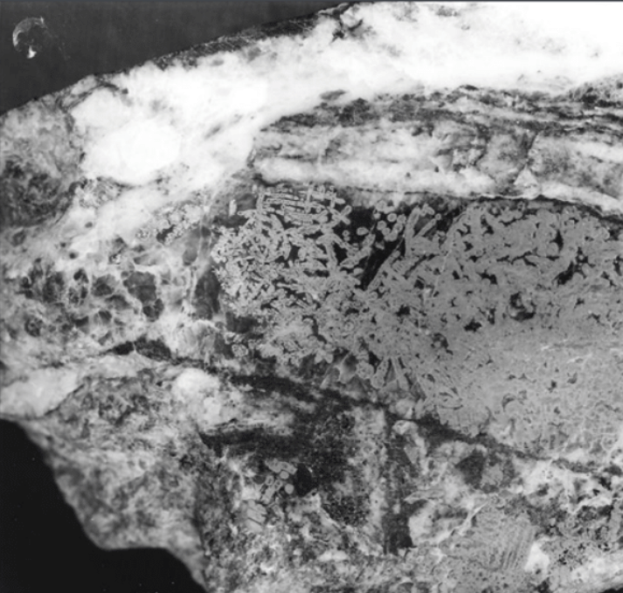
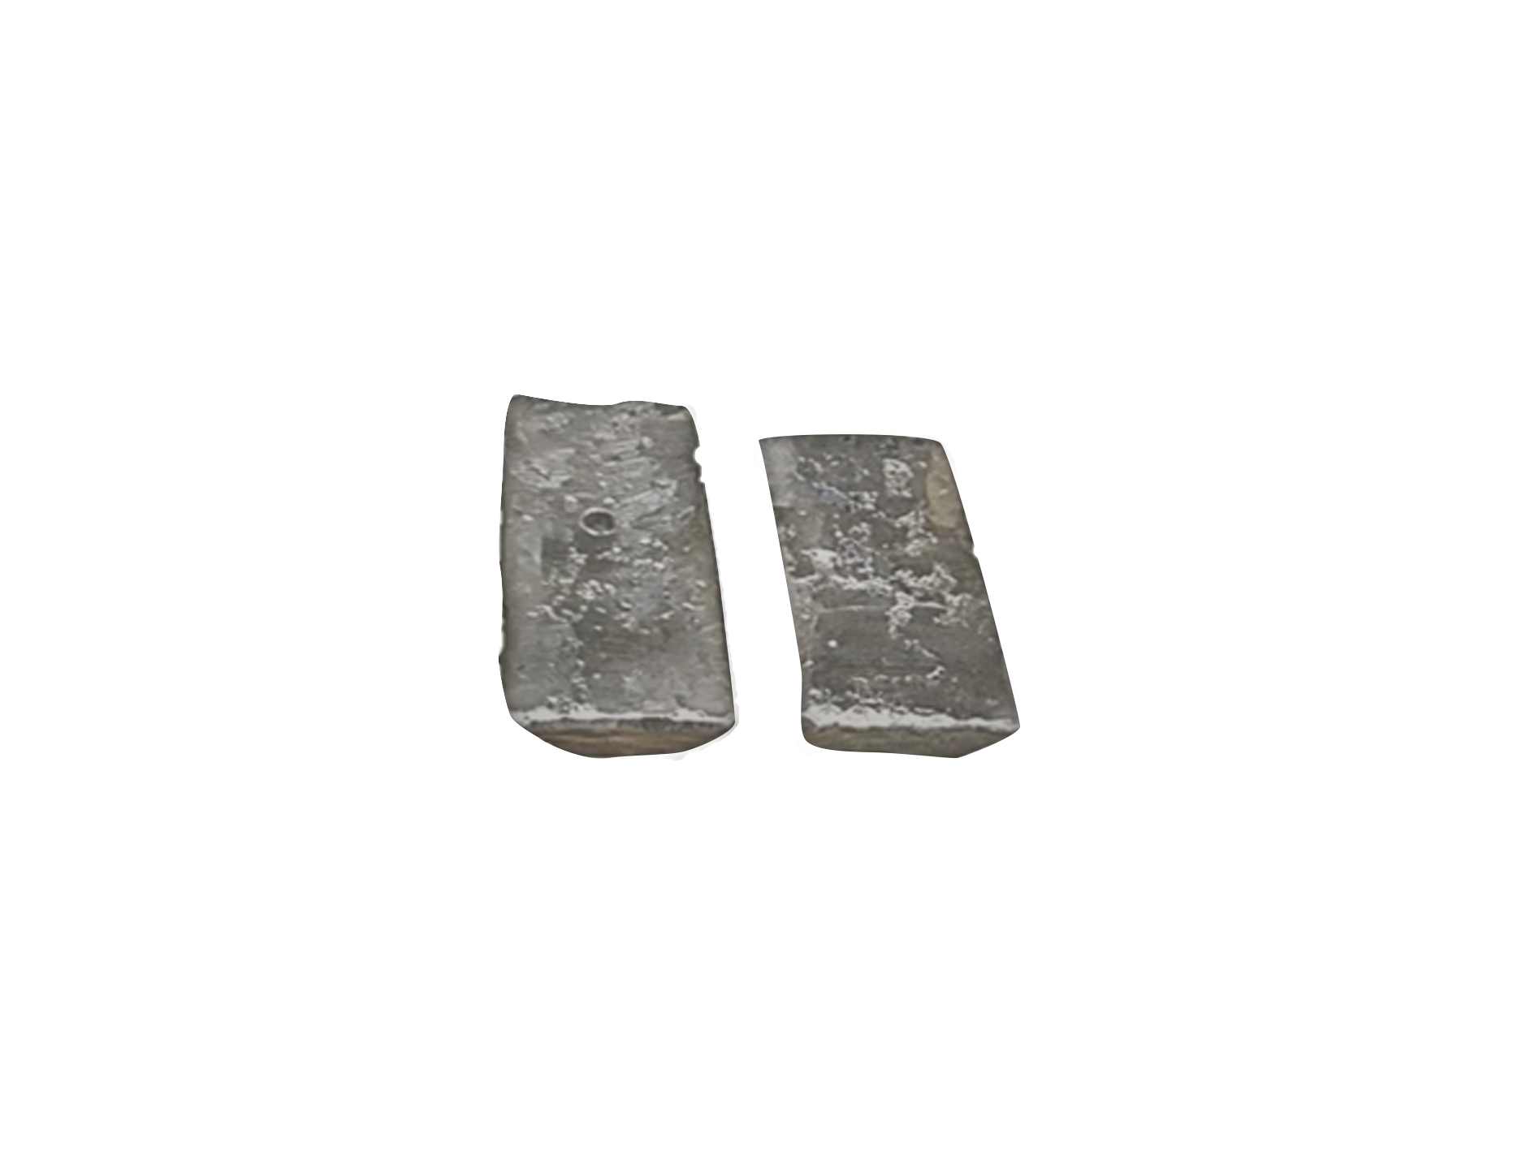
TSX-V NTH | OTCQB CCWOF | FF QN3
Cobalt-Gowganda Region
High Level Strategy
Gowganda Camp Consolidation
Primary Silver | Secondary Cobalt Copper Nickel
Dual Track Strategy
Tailings Re-Processing
Beaver:
79 g/t, 48 K tonnes
Gowganda (Miller Lake-O’Brien):
47.5 g/t, 1,940,000 tonnes
Castle Mine:
459 g/t Ag
Exploration
Castle:
Past producer:
9.4 Moz Ag,
376 K lbs Co
Miller Lake-O’Brien:
Produced 40.7 Moz Ag
785.7 K lbs Co
Castle East:
Historic Inferred Average Grade 8,582 g/t, 32.9 K tonnes
+

Slide 8
TSX-V NTH | OTCQB CCWOF | FF QN3
Properties
Group of properties in the Historic Cobalt Camp

Slide 9
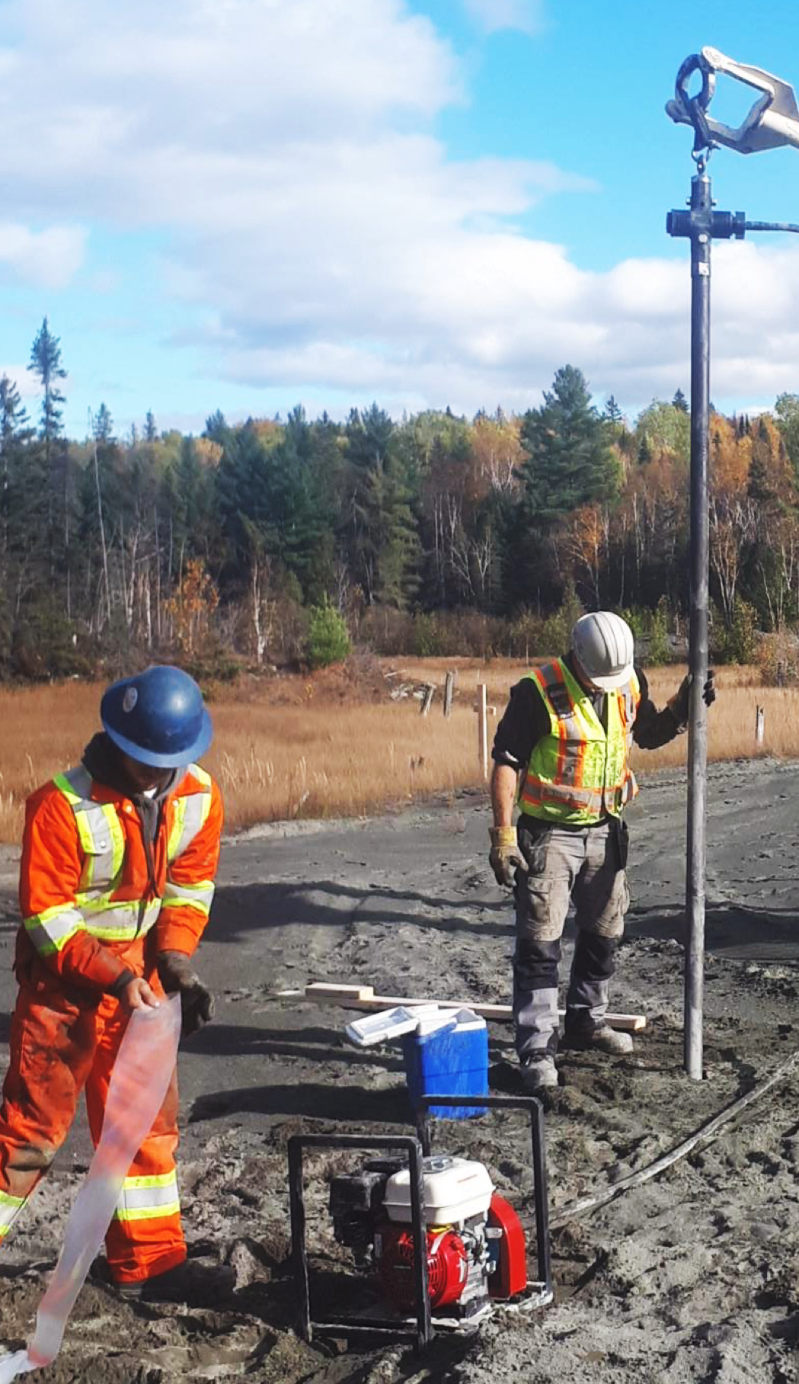
TSX-V NTH | OTCQB CCWOF | FF QN3
Next Year
Short Term Schedule
Recovery Permit for tailings processing
Commissioning the 600 tpd gravity plant
First silver dore pour from consolidated tailings feed
Phase II drilling
on the consolidated district
Updated NI 43-101 mineral resource estimate for tailings
Notes:
What to replace with
Who can do this?
Put titles om it

Slide 10
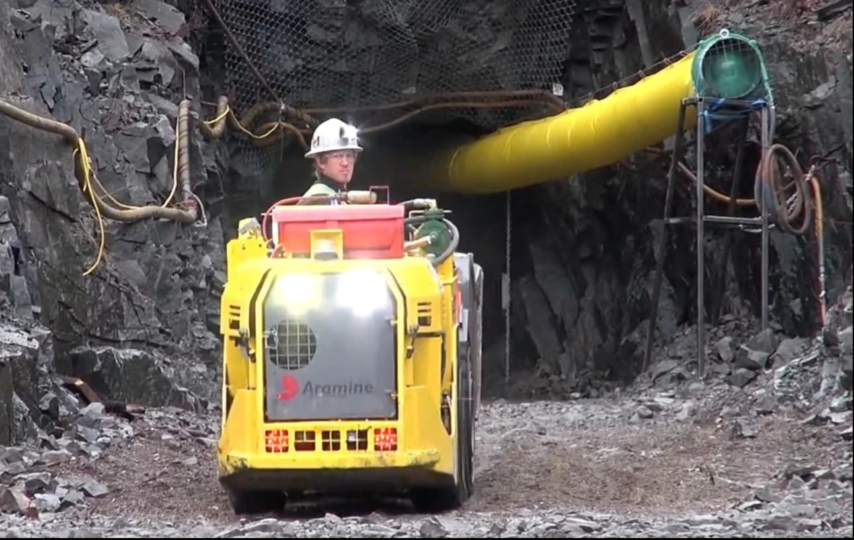
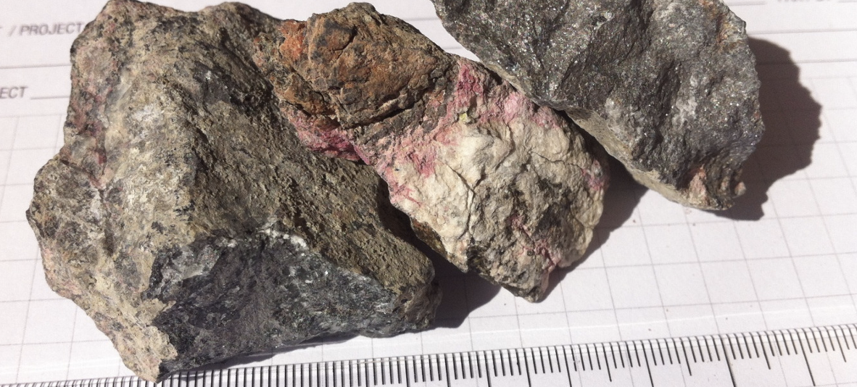
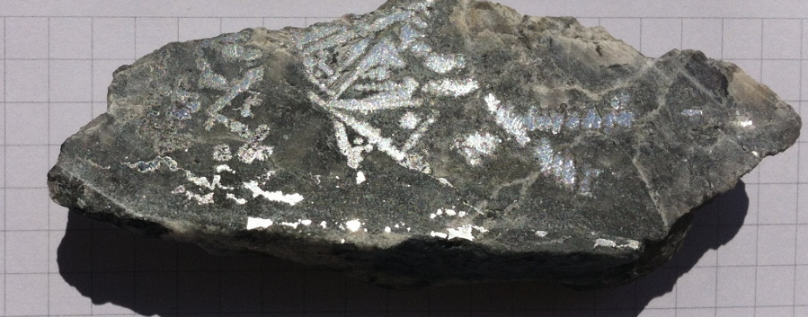
TSX-V NTH | OTCQB CCWOF | FF QN3
Nord Precious Metals
Castle Mine
Past producer of 9.4 million ounces silver and 376,000 lbs cobalt.
3 shafts accessing 11 levels to 259 m depth
Underground drilling returned up to 5.2% Co and 13,208 g/t Ag
Miller Creek tailings: up to 411 g/t AgEq
100% owned properties
Direct access via Hwy 560W from Elk Lake
Contiguous to multiple historic mines
The best intersection encountered is from hole CA1108 at 563.54-566.63 m. Assays rendered an uncut weighted average grade of 6,476 Ag g/t, 0.14% Co, 0.03% Ni over 3.09 m. This interval includes 40,944 Ag g/t, 0.91% Co, 0.12% Ni over 0.45 m located at 564.34-564.79m.The bulk of the silver is in a 7 cm (true width) calcite-Co-Ag vein at 28° to the core axis from 564.64-564.77 m. Leaf silver was common in the wall rock in the reported interval.
Notes:
We have historic here. Take whats left in stopes to use for material to process.
We have processed some of this material
Significant cobalt.
Would do backfill paste on stopes.

Slide 11
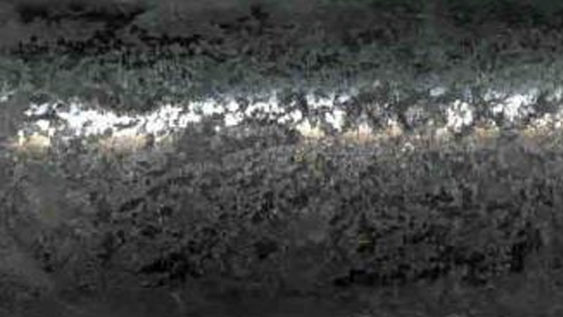
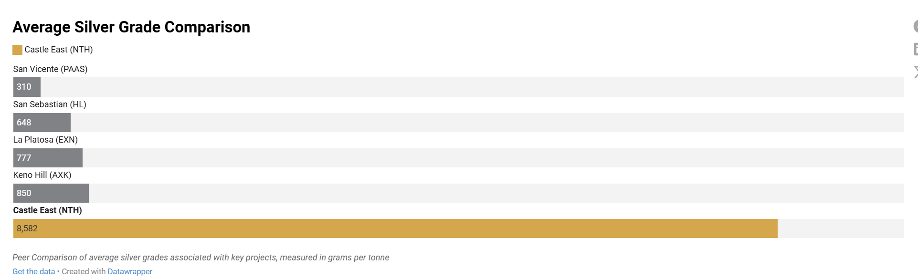
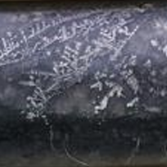
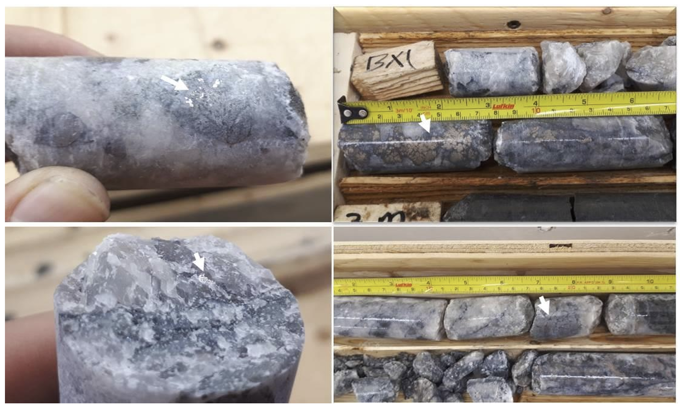
Royalties: 1% NSR GGM, 5% NSR to previous vendor, and 5%...??
TSX-V NTH | OTCQB CCWOF | FF QN3
Nord Precious Metals
Castle East Silver
*part of Castle Mine Property
Inferred Mineral Resource | Ag g/t | Co g/t | Cu g/t | Ni g/t | Ag Eq g/t | Tonnes | Ag Oz | Ag Eq Oz
Total Inferred Mineral Resource | 7,149 | 2,537 | 628 | 467 | 7,325 | 32,900 | 7,567,000 | 7,752,700
Exceptionally rich, narrow veins extending tens to hundreds of meters, hosting native silver with Ag-Co-Ni-As-Bi mineralization in dense parallel vein and fracture networks.
Properties are 100%-owned, minor NSR
Access to the Castle Mine Site via Hwy560W from Elk Lake.
World's Highest Grade Silver Resource
89,853 g/t silver over 0.3m ranks among the richest silver intercepts ever drilled. Initial resource of 7.56 million ounces at 8,582 g/t established from two vein sections. Ongoing 60,000m drill program targeting 30-100 million ounce potential.
Notes:
Castle east part of castle property

Slide 12
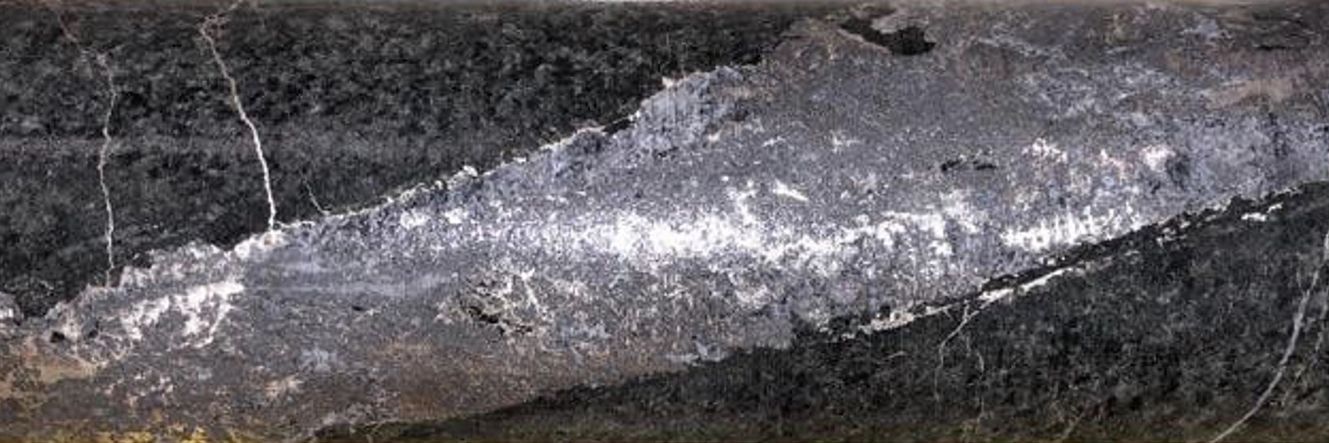
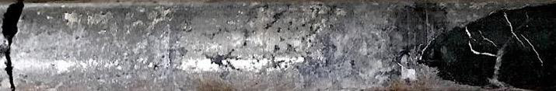
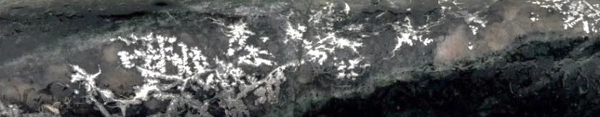
TSX-V NTH | OTCQB CCWOF | FF QN3
TSX-V NTH | OTCQB CCWOF | FF
Castle East: Castle Property
Boasts Highest Silver Grades in the World
Drill Highlights include:
89,859 g/t Ag (2,621 oz/tonne Ag) over 0.30m
Gold Equivalent: 42.96 oz/tonne AuEq
50,583 g/t Ag (1,626 oz/tonne Ag) + 0.30% Co over 0.60m
Gold Equivalent: 24.19 oz/tonne AuEq
70,380 g/t Ag (2,263 oz/tonne Ag) + 2.61% Co over 0.30m
          Gold Equivalent: 33.65 oz/tonne AuEq
Castle East is only the beginning — over 2 km between Castle East and the historic Castle Mine remains largely unexplored by modern methods

Slide 13
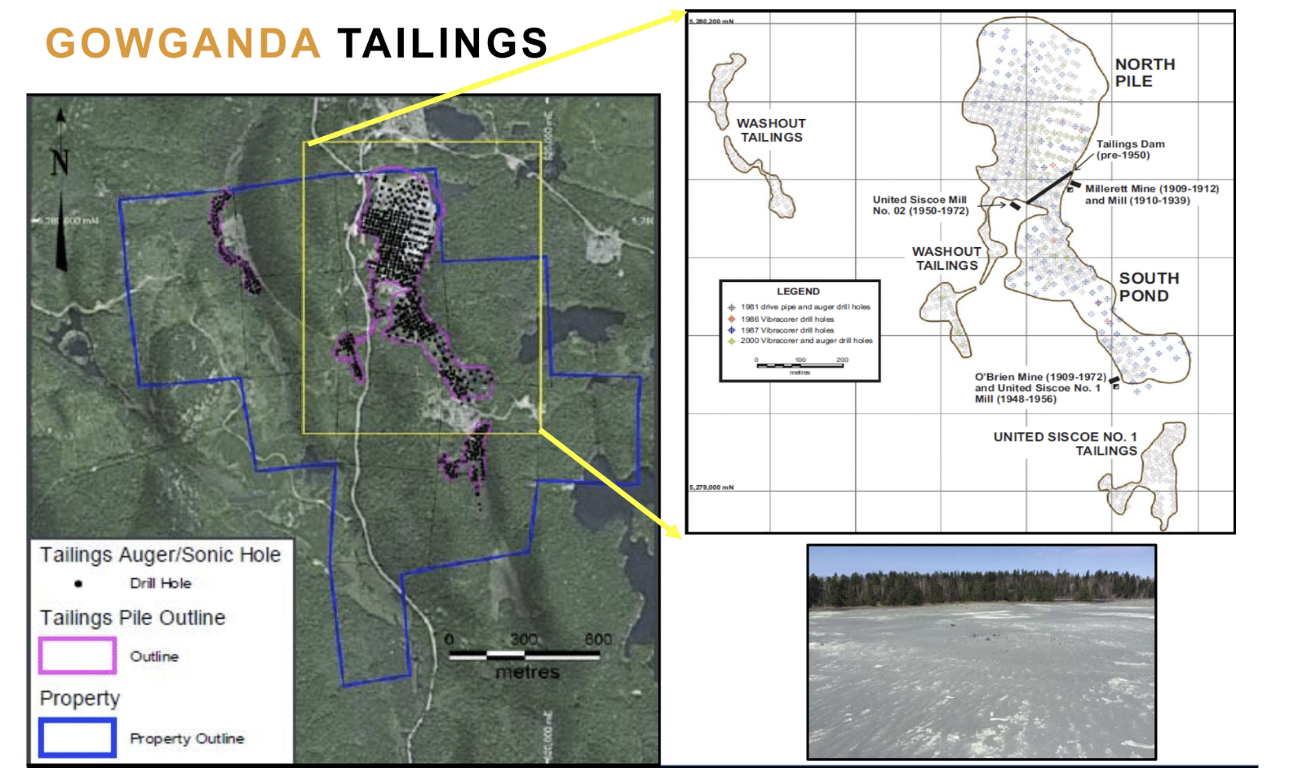
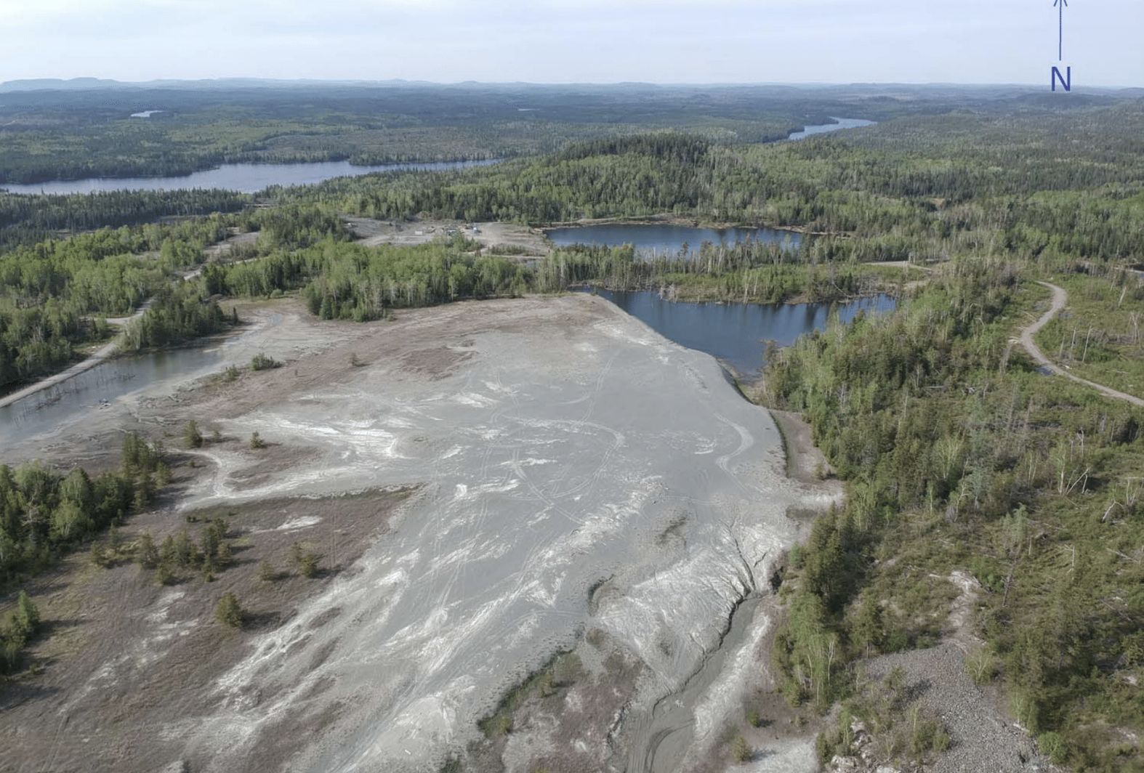
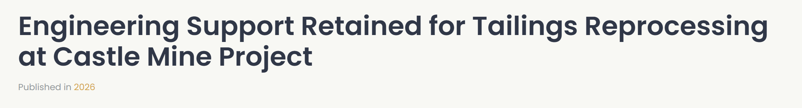
TSX-V NTH | OTCQB CCWOF | FF QN3
Nord Precious Metals
Gowganda Tailings
Cut-off Grade (Ag g/t) | Tonnes | Grade (g/t) | Ozs
5.0 g/t | 1,946,465 | 47.3 | 2,961,665
10 g/t | 1,937,520 | 47.5 | 2,959,487
20 g/t | 1,903, 081 | 48.1 | 2,941,810
30 g/t | 1,743,690 | 50.1 | 2,806,483
40 g/t | 1,112,423 | 58.2 | 2,083,075
Miller Lake- O’Brien tailings deposit recently acquired and undergoing further evaluation.
From 2011 historic resource estimate

Slide 14
TSX-V NTH | OTCQB CCWOF | FF QN3
Long Term Value Creation
The Flattened Curve
Tailings reprocessing compresses the mining lifecycle: from orphan period to production in months, not decades.
MARKET VALUE
Conventional (Lassonde)
Tailings reprocessing
CONCEPTION
DISCOVERY
ORPHAN PERIOD
FEASIBILITY
DEVELOPMENT
PRODUCTION
DEPLETION
PROJECT LIFECYCLE →
01
TAILINGS ON
SURFACE
02
GRADE UPLIFT
ECONOMICS
03
RESTART, NOT
GREENFIELD
04
3M OZ/YR
ALREADY POURING
05
HUB-AND-SPOKE
RESILIENCE
06
DRILLING BUILDS
FUTURE FEED
1.94 Mt @ 47.5 g/t Ag
47.5 → 2,114 g/t
8 past-prod shafts
1,000 oz Ag/yr (TTL)
Stockpile by grade
Past prod = pipeline
14

Slide 15
TSX-V NTH | OTCQB CCWOF | FF QN3
Corporate Overview
Corporate Details
$32.75M Market Cap 12-05-2026 | 0.24 CAD Share price 12-05-2026
0.11-0.47 52 week share price Range | 5.2% Insider Held 05-2026
136,359,089 Issued & Outstanding 05-2026 | 65,712,285 Warrants & Options Outstanding 06-2026 |  | Resource
 |  |  | 7.5M oz Silver Inferred Resource Deposit Size 05-2021 43-101 (2) |  | 8,582 g/t Castle East Average Resource Grade (250 oz/ton) 05-2021 (2)
NTH TSX-V | QN3 FF | CCWOF OTCQB
Notes:
https://www.nordpreciousmetals.com/financials/2024/Q2.pdf
https://www.nordpreciousmetals.com/reports/2021may.pdf

Slide 16
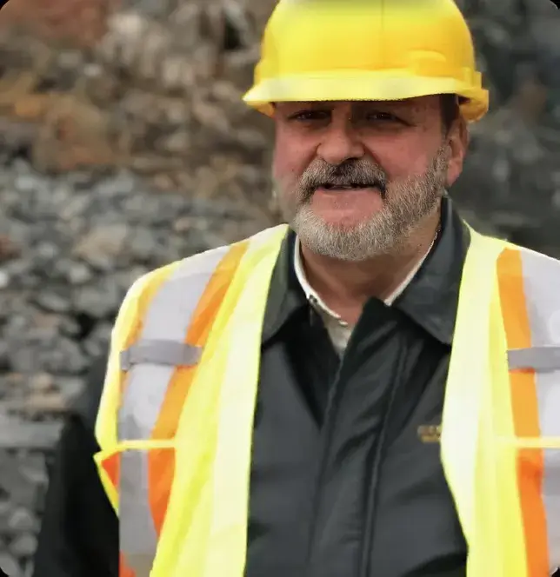
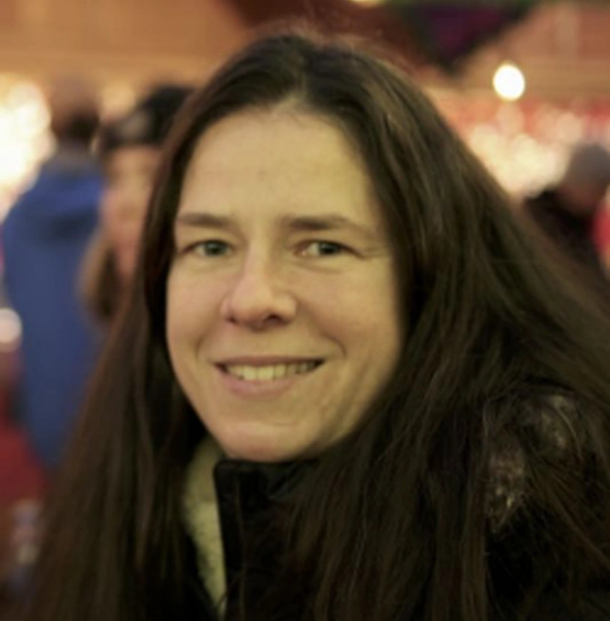

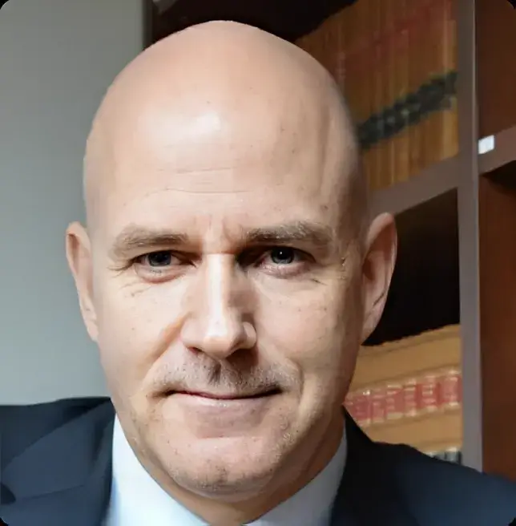

TSX-V NTH | OTCQB CCWOF | FF QN3
Management & Board
Frank Basa Chairman & CEO | 28+ years in hydrometallurgical engineering. Designed and operated plants processing 3M oz silver annually. Led TTL acquisition and upgrade. Previously technical lead at major operations globally.
Heidi Gutte Chief Financial Officer | 15+ years experience with publicly-traded mining companies, specializing in corporate finance, IFRS reporting, audit preparation and response, tax optimization, corporate compliance. Bachelor's degree in computer engineering and member of Chartered Professional Accountants of British Columbia and Canada.
Matthew Halliday Technical Advisor and Director | 13+ years in exploration and as a resource geologist with Kirkland Lake Gold, First Cobalt and SGS Geostat. Led exploration program that discovered Castle East. Expert in Cobalt camp's vein systems. Published research on camp geology. Instrumental in expanding resource from 2M to 7.5M oz.
Daniel Barrette Director | Canadian mining executive with 20 + years of experience in corporate development, project structuring, and financing in the mining sector. Held leadership roles in both public and private companies, with expertise in strategic partnerships, project advancement, and capital markets.
Yannick Benoit Government Affairs Advisor | Yannick Benoit is a corporate and commercial lawyer whose practice spans mining, forestry, and natural resource transactions. He has served as an advisor to NORCAT, Northern Ontario Angels, and the Ontario Bar Association.
Notes:
Check about Yannick
Maybe strategic advisors?

Slide 17
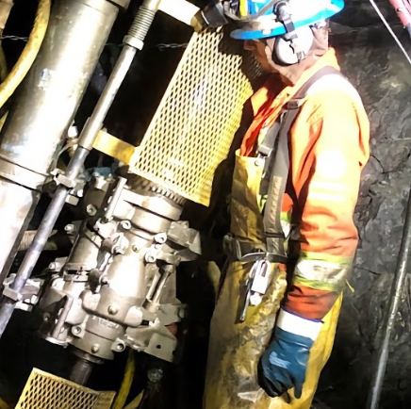

TSX-V NTH | OTCQB CCWOF | FF QN3
FRANK BASA P.Eng
CEO President
frank@nordpreciousmetals.com+1 416 625 2342
WAYNE CHEVELDAYOFF
Corporate Communications
waynecheveldayoff@gmail.com
+1 416-710-2410
OFFICE
1 Presley Street
Cobalt Ontario
P0J 1K0
nordpreciousmetals.com
www.nordpreciousmetals.com

Slide 18
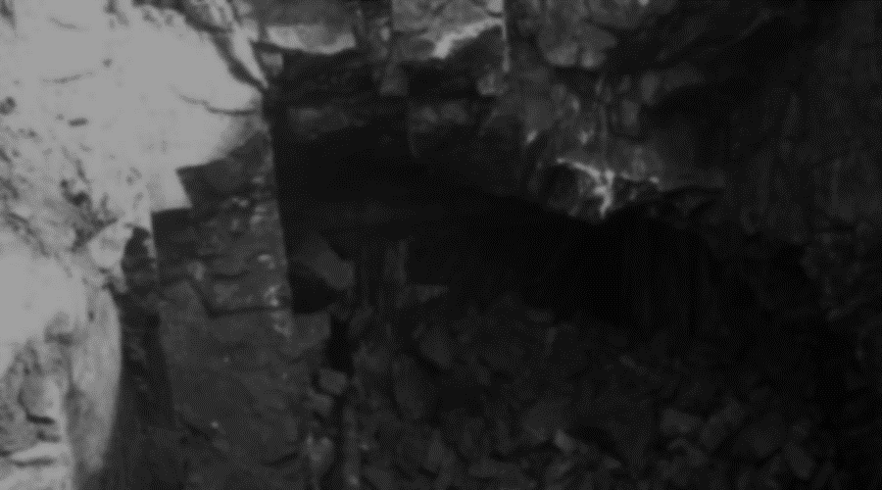
APPENDIX
TSX-V: NTH . OTCQB: CCWOF . FF: QN3

Slide 19
Castle East Project
First Ever Resource at the Camp
TSX-V NTH | OTCQB CCWOF | FF QN3
Mineral Resource Estimate at Castle East (43-101)
 | Tonnes | Ag g/t | Co g/t | Cu g/t | Ni g/t | AgEq g/t | Ag oz | AgEq oz
Zone 1A | 8,100 | 7,960 | 946 | 349 | 790 | 8,042 | 2,073,000 | 2,094,200
Zone 1B | 19,300 | 8,843 | 2,308 | 325 | 336 | 8,998 | 5,487,200 | 5,583,200
Zone 2A | 5,500 | 38 | 5,673 | 2,101 | 453 | 426 | 6,800 | 75,300
Total | 32,900 | 7,149 | 2,537 | 628 | 467 | 7,325 | 7,567,000 | 7,752,700
Average Silver Grade (zone 1A,1B): 8,582 g/t (250 Ag oz/ton)
Total: 7.5 m oz Inferred Resource
Mineral resources that are not mineral reserves do not have demonstrated economic viability. For full details, see the following report filed on Sedar and on the Company’s website: NI 43-101 Technical Report Update for Castle East, Ontario, Canada, Effective date: 30 April, 2021 Issue date: 25 May, 2021 prepared by GoldMinds Geoservices Inc. by Independent QP Merouane Rachidi, P. Geo., Ph.D in accordance with National Instrument 43-101. Mineral Resource is reported with mineable shape cut-off grade equivalent to 125$USD (258 g/t AgEq) including mining, shipping and smelting cost with recovery of 95%.

Slide 20
TSX-V NTH | OTCQB CCWOF | FF QN3
1987 Kilborn Feasibility Study
325,000 oz Silver/Year for 7 Years at Gowganda
1,000 TPD / 8-month seasonal
225,000 tons processed per year
1
RESOURCE BASE
1,827,000
325,000 oz Ag/year × 7 years
~2.0M recoverable oz @ 85% recovery
2
tons of proven tailings @ 1.43 oz/t Ag
49.3% IRR at US$12/oz
Kilborn projection (1987 dollars)
764
drill holes across 3 campaigns (1981, 86-87, 2000)
3
98.9%
silver precipitation efficiency (Merrill-Crowe)
Validated across four decades
Six independent test programs, 1981–2011
$4.5M
CAPEX in 1987 CDN; $1.255M/yr OPEX
4

Slide 21
TSX-V NTH | OTCQB CCWOF | FF QN3
FINANCIAL SENSITIVITY
Modelled at $6–$12/oz — economics scale with silver price
Silver Price
(US$/oz)
Capital (CDN)
IRR
NPV @ 15%
AT CURRENT SILVER PRICES
$6
$4.7M
7.8%
($618K)
49.3%
$8
$4.7M
24.7%
$767K
$10
$4.7M
37.3%
$1,586K
Internal Rate of Return
Modelled at US$12/oz silver
$12
$4.7M
49.3%
$2,257K
NPV (15%): +$2,257K
Kilborn 1987 base case — economics flip from negative at $6/oz to strongly positive at $12/oz.
Source: Kilborn (1987). NPV at 15% discount. 1987 CDN dollars.
Today's silver price exceeds Kilborn's $12/oz top-case scenario by a wide margin.

Slide 22
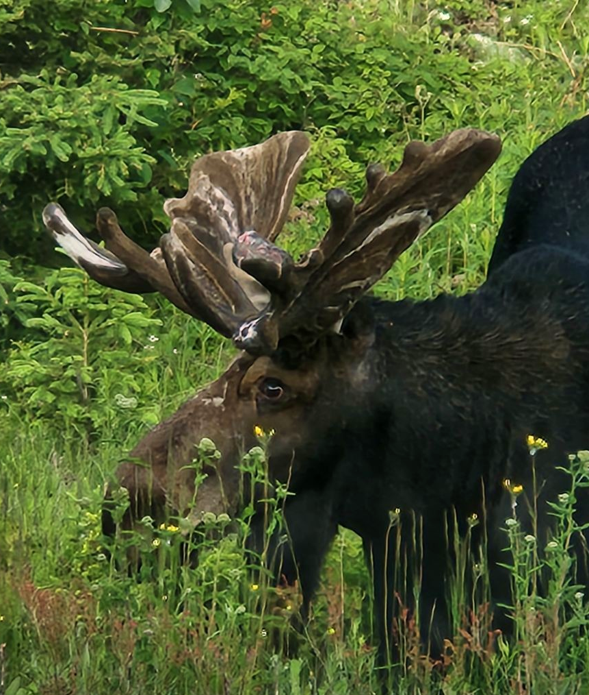
TSX-V NTH | OTCQB CCWOF | FF QN3
Nord Precious Metals
Sustainability
Environmental
Mining and processing of metals critical for the clean energy transition.
Rehabilitation of past-producing properties through re-processing tailings and restoring forested areas and trails.
Development and use of clean processes for Temiskaming Testing Labs and Re-2Ox
Social
Agreements with Matachewan First Nation, Temagami First Nation, and the Teme-Augama Anishnabai to ensure responsible development of properties within First Nations traditional territory.
Governance
Our values are guided by those laid out by the Responsible Mining Foundation. We undertake the appropriate engagement that each stakeholder requires for their needs.

Slide 23
TSX-V NTH | OTCQB CCWOF | FF QN3
Nord Precious Metals
End Notes
7.2 moz beaver, 9.4Moz castle, 40.7Moz miller lake
Historic Resource. For full details, see the following report filed on Sedar and on the Company’s website: NI 43-101 Technical Report Update for Castle East, Ontario, Canada, Effective date: 30 April, 2021 Issue date: 25 May, 2021 prepared by GoldMinds Geoservices Inc. by Independent QP Merouane Rachidi, P. Geo., Ph.D in accordance with National Instrument 43-101. Mineral Resource is reported with mineable shape cut-off grade equivalent to 125$USD (258 g/t AgEq) including mining, shipping and smelting cost with recovery of 95%.

